Slide 1




Driving Market Leadership: Insights to Propel Goodcabs' Tier- II Mobility Growth
Domain: Transportation & Mobility
Function: Operations
-Presented by Joyeta Pal

Slide 2
Company Overview:
Goodcabs, established two years ago, operates in 10 tier-II cities.
Empowering local drivers, enabling them to build sustainable livelihoods.
Prioritize passenger satisfaction & driver well-being, establishing it as a trusted mobility partner.

Slide 3
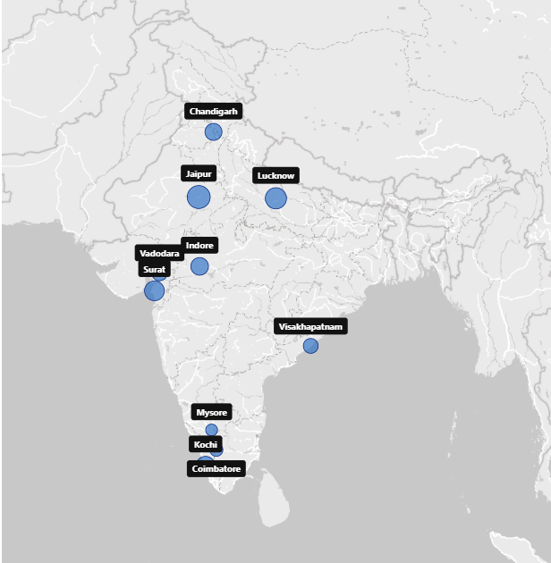
Goodcabs Market
Chandigarh
Coimbatore
Indore
Jaipur
Kochi
Lucknow
Mysore
Surat
Vadodara
Visakhapatnam

Slide 4
Agenda:
Problem Statement
Project Objective
Data Overview
Detailed Analysis
Ad-Hoc Business Requests
Primary & Secondary Analysis
Dashboard Overview
Recommendations

Slide 5
Problem Statement:
Far from reaching its market penetration goals.
Struggling to meet its ambitious 2024 targets.

Slide 6
Project Objective:
Comprehensive analysis of Goodcabs' performance across key metrics.
Help identify critical growth opportunities, address operational inefficiencies, and provide actionable insights.
Support strategic decision-making and drive the company’s growth in tier-II cities.

Slide 7
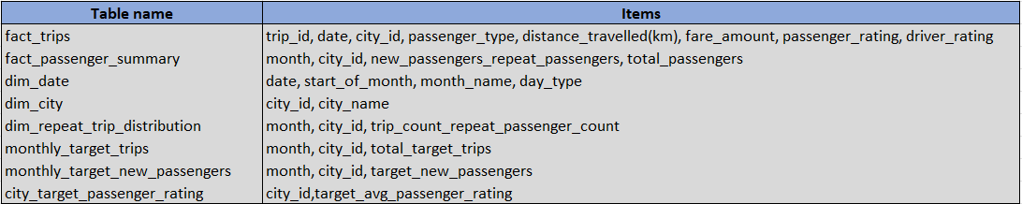
Data Overview:
Received two SQL databases, targets_db and trips_db, containing the tables mentioned below. The dataset includes values spanning from January 1, 2024, to June 30, 2024.
Dataset

Slide 8

Ad-Hoc Business Requests, Queried Results & Insights Generated
Tool:

Slide 9
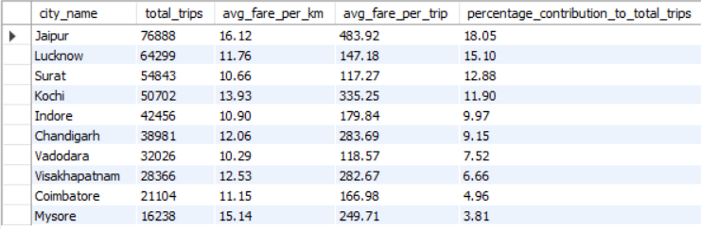
Business Request - 1: City-Level Fare and Trip Summary Report
Generate a report that displays the total trips, average fare per km, average fare per trip, and the percentage contribution of each city’s trips to the overall trips.

Slide 10
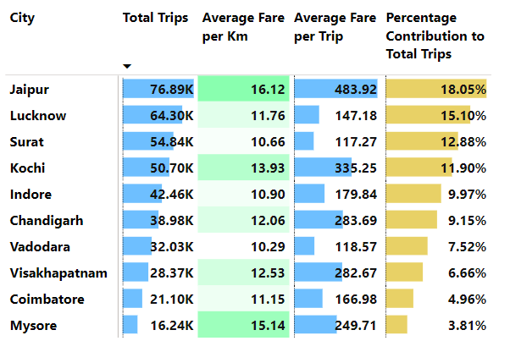
Pricing Strategy in Different City Segments:
High Average Fare Cities (Tourism-Focused) Jaipur | Mysore | Kochi
Low Average Fare Cities (Business-Focused) Lucknow | Surat | Indore | Vadodara | Coimbatore
Balanced Cities (Tourism & Business) Chandigarh | Visakhapatnam

Slide 11
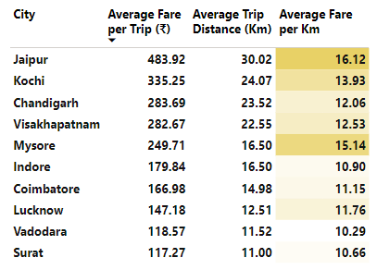
PA-2
Cities with the Highest and Lowest Average Fare per Trip and comparison of Average Fare per Trip with Average Trip Distance Across Cities
Jaipur reports the highest average fare per trip (₹483.92), which aligns with its longer average trip distance (30.02 Km).
Surat (₹117.27), reports the lowest average fare per trip, consistent with its shorter average trip distance (11 Km).
Contrasting Pricing Approaches despite similar average trip distances Mysore (Tourism): Higher average fare per kilometer (₹15.14), aligned with premium services. Indore (Business): Lower average fare per kilometer (₹10.90), catering to price-sensitive daily commuters.

Slide 12
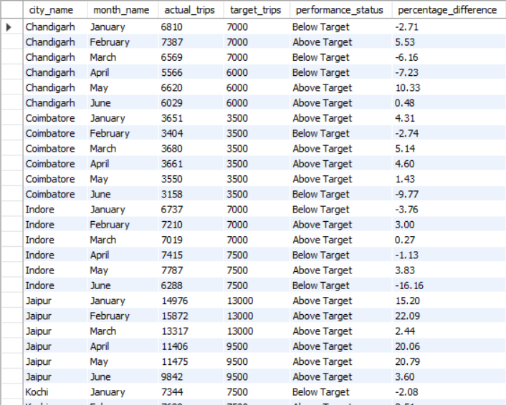
Business Request - 2: Monthly City-Level Trips Target Performance Report
Generate a report that evaluates the target performance for trips at the monthly and city
level. For each city and month, compare the actual total trips with the target trips and categorize the performance as follows:
If actual trips are greater than target trips, mark it as "Above Target".
If actual trips are less than or equal to target trips, mark it as "Below Target".
Additionally, calculate the % difference between actual and target trips to quantify the performance gap.

Slide 13
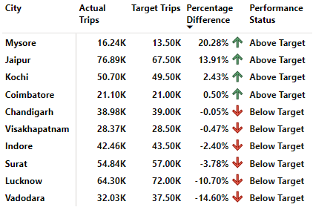
BR-2 & PA-7(a)
Performance Analysis: Tourism vs. Other Cities
Strong Performers: Mysore (+20.28%) and Jaipur (+13.91%) surpassed performance targets.
Weak Performers: Lucknow (-10.70%) and Vadodara (-14.60%) underperformed, missing their targets significantly.

Slide 14
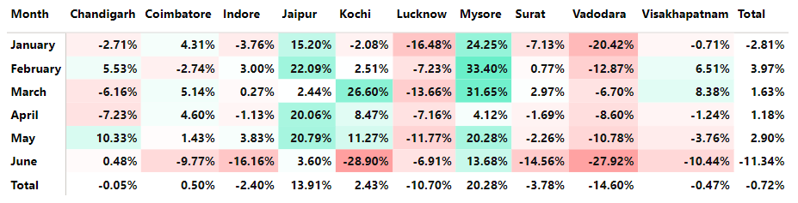
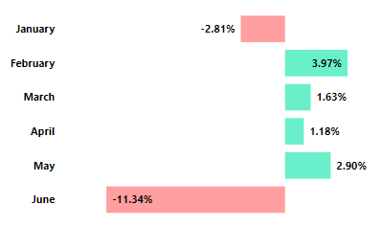
Consistent Performers: Mysore and Jaipur consistently surpassed targets throughout all months.
Underperforming Cities: Lucknow and Vadodara consistently fell short of targets in all months.
Key Month: February (+3.97%) & May (+2.90%) stood out as the best month, with trip targets achieved across most cities.
Challenging Months: January (-2.81%) & June (-11.34%) were the worst-performing month.

Slide 15
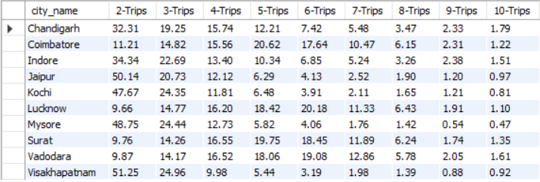
Business Request - 3: City-Level Repeat Passenger Trip Frequency Report
Generate a report that shows the percentage distribution of repeat passengers by the number of trips they have taken in each city. Calculate the percentage of repeat passengers who took 2 trips, 3 trips, and so on, up to 10 trips.

Slide 16
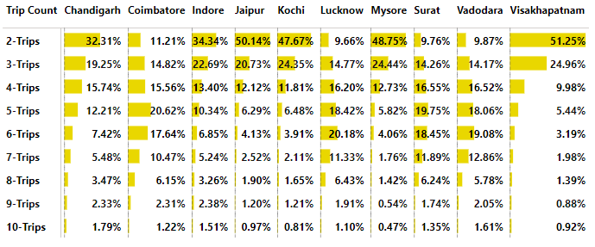
BR-3 & PA-6
Repeat Passenger Trip Frequencies: The repeat passengers' trip frequencies consistently decline from 2 trips to 10 trips.
Tourism/Getaway Culture-Focused Cities (2-Trip Share): Visakhapatnam (51.25%), Jaipur (50.14%), Mysore (48.75%), and Kochi (47.67%) show a high trend for 2-trip shares.
Business & Commuter Cities (~4-6 Trip Share): Coimbatore, Surat, Lucknow, and Vadodara display a higher trend for around 4-6 trip frequencies.

Slide 17
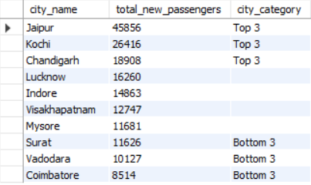
Business Request - 4: Identify Cities with Highest and Lowest Total New Passengers
Generate a report that calculates the total new passengers for each city and ranks them based on this value. Identify the top 3 cities with the highest number of new passengers as well as the bottom 3 cities with the lowest number of new passengers, categorizing them as "Top 3" or "Bottom 3" accordingly.

Slide 18
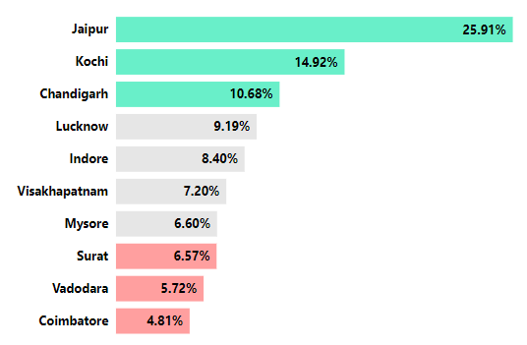
Top Cities for New Passengers: Jaipur (25.91%), Kochi (14.92%), and Chandigarh (10.68%) lead in the number of new passengers.
Bottom Cities for New Passengers: Surat (6.57%), Vadodara (5.72%), and Coimbatore (4.81%) have the lowest new passenger numbers.
46K
26K
19K
16K
15K
13K
12K
12K
10K
9K

Slide 19
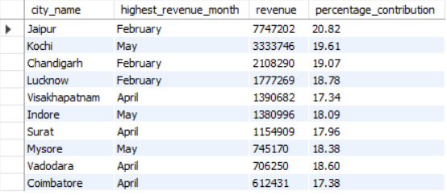
Business Request - 5: Identify Month with Highest Revenue for Each City
Generate a report that identifies the month with the highest revenue for each city. For each city, display the month_name, the revenue amount for that month, and the percentage contribution of that month’s revenue to the city’s total revenue.

Slide 20
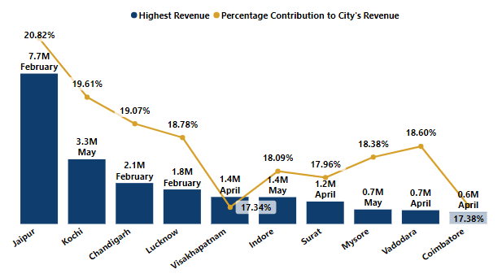
Peak Revenue Months (All Cities): February, April, and May are the highest revenue-generating months.
Cities with Highest Peak Revenue: Jaipur experienced a revenue spike in February, reaching ₹7.7M (~21% of its total revenue). Kochi experienced a revenue spike in May, reaching ₹3.3M (~20% of its total revenue).
Cities with Lowest Peak Revenue: Surat, Mysore, Vadodara, and Coimbatore recorded the lowest peak revenues.

Slide 21
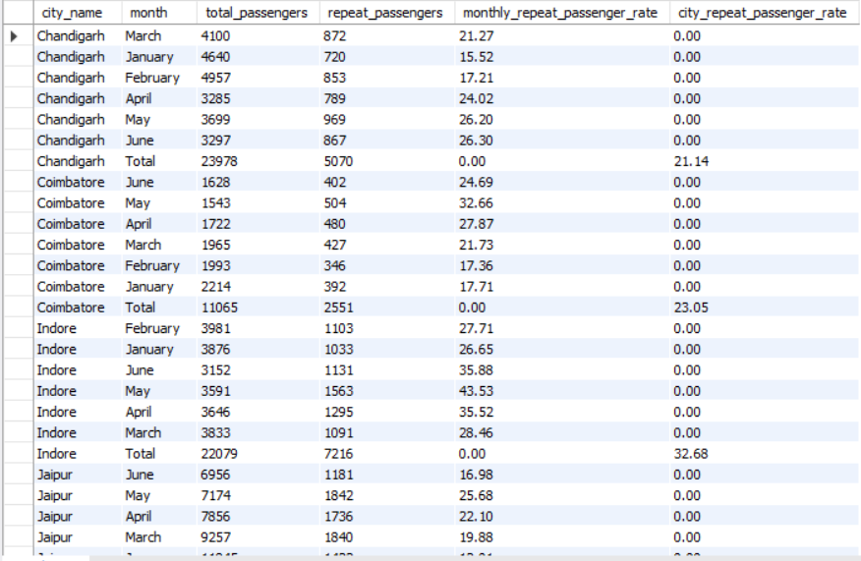
Business Request - 6: Repeat Passenger Rate Analysis
Generate a report that calculates two metrics:
1. Monthly Repeat Passenger Rate: Calculate the repeat passenger rate for each city and month by comparing the number of repeat passengers to the total passengers.
2. City-wide Repeat Passenger Rate: Calculate the overall repeat passenger rate for each city, considering all passengers across months.

Slide 22
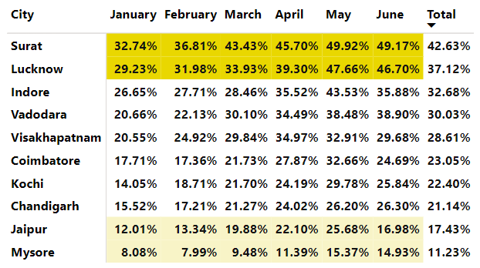
BR-6 & PA-8
Cities with High RPR (Business-centric) Surat (42.63%) and Lucknow (37.12%) lead with the highest Repeat Passenger Rates (RPR).
Low RPR Cities (Tourist-centric) Mysore (11.23%) and Jaipur (17.43%) report the lowest Repeat Passenger Rates (RPR).

Slide 23
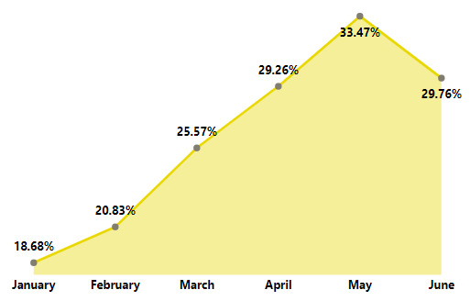
Month with highest RPR May (33.47%) recorded the highest Repeat Passenger Rate (RPR) among the months.
Month with lowest RPR January had the lowest Repeat Passenger Rate (RPR) at 18.68% among the months recorded so far.

Slide 24
Primary Analysis

Slide 25
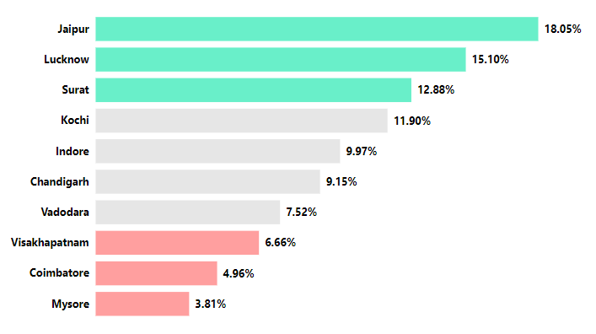
PA-1
Top and Bottom Performing Cities Top 3 and bottom 3 cities by total trips over the entire analysis period.
Top 3 Cities by Trip Volumes Jaipur(18.05%) - Driven by tourism demand. Lucknow (15.10%) and Surat (12.88%) - Driven by business demands.
Bottom 3 Cities by Trip Volumes Visakhapatnam (6.66%), Coimbatore (4.96%), and Mysore (3.81%) - Report the lowest trip volumes.
Top 3
Bottom 3

Slide 26
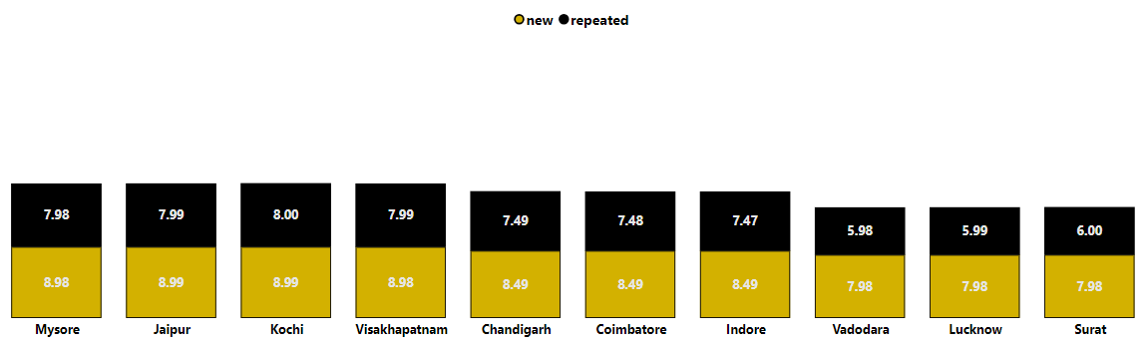
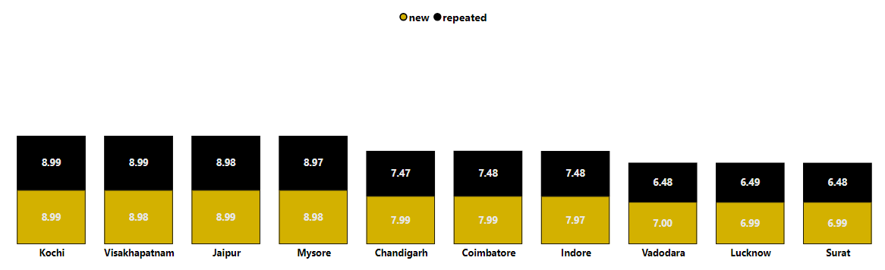
Average Passenger & Driver Ratings by City and Passenger Type
PA-3
Average Passenger Rating
Cities with High Passenger Rating Mysore (8.70), Jaipur (8.58), and Kochi (8.52) consistently achieve high average passenger rating.
Cities with High Driver Rating Kochi (8.99), Visakhapatnam (8.99), and Jaipur (8.99) report higher average driver rating.
Cities with Low Rating Business focused cities like Vadodara, Lucknow, and Surat consistently receive lower average passenger and driver rating.
8.70
8.58
8.52
8.43
7.98
7.88
7.83
6.61
6.49
6.42
Average Driver Rating
8.99
8.99
8.99
8.98
7.72
7.69
7.65
6.65
6.62
6.59

Slide 27
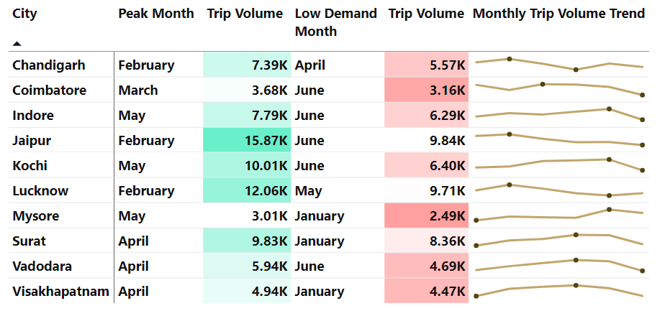
PA-4
Peak and Low Demand Months by City
Peak Trip Demand Months For most cities, February, April, and May experienced the highest trip volumes.
Low Trip Demand Months For most cities, January and June recorded the lowest trip volumes.

Slide 28
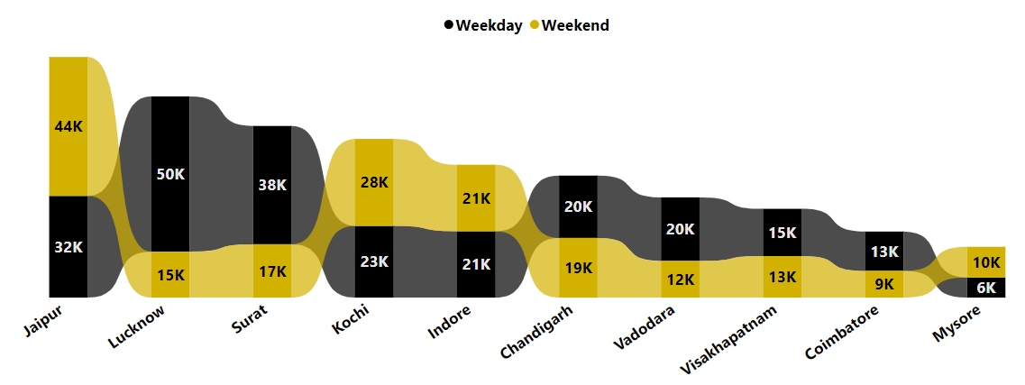
PA-5
Weekend vs. Weekday Trip Demand by City
Strong Weekend Demand Tourism-focused cities like Jaipur, Kochi, and Mysore see higher weekend trip volumes.
Strong Weekday Demand Business-focused cities like Lucknow, Surat, and Vadodara experience higher weekday trip volumes.

Slide 29
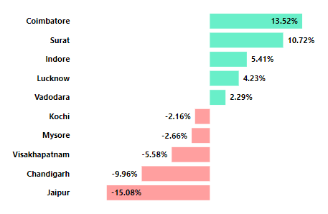
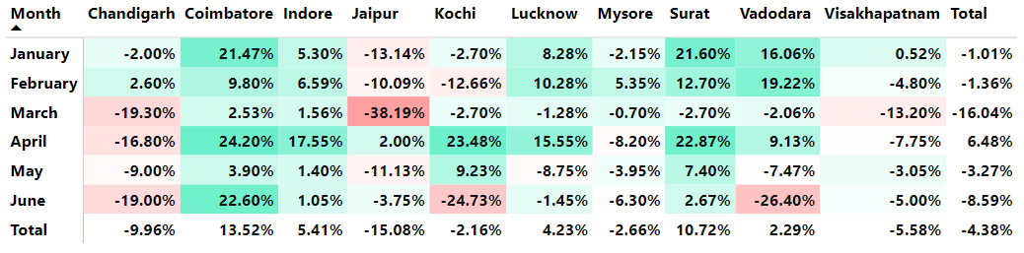
Monthly Target Achievement Analysis for New Passengers
PA-7(b)
Cities That Exceeded Targets Business-focused cities tend to achieve or even exceed their targets for new passenger acquisition.
Cities That Missed Targets Tourism-focused cities or those with a balanced mix of tourism and business tend to underperform.
Monthly Performance Trends: March (-16.04%): The weakest month for new passenger acquisition. April (+6.48%): The only month in which most cities met their targets.

Slide 30
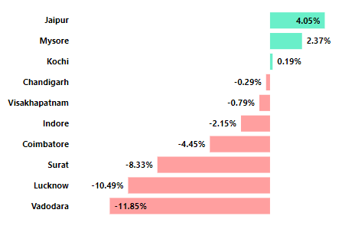
PA-7(c)
Target Achievement Analysis for Average Passenger Ratings
Cities That Exceeded Targets All tourism-focused cities surpassed their target for average passenger ratings, reflecting high customer satisfaction.
Cities That Missed Targets Other cities fell short of their targets for average passenger ratings, with the lowest performers being Surat (-8.33%), Lucknow (-10.49%), and Vadodara (-11.85%).

Slide 31
Secondary Analysis

Slide 32
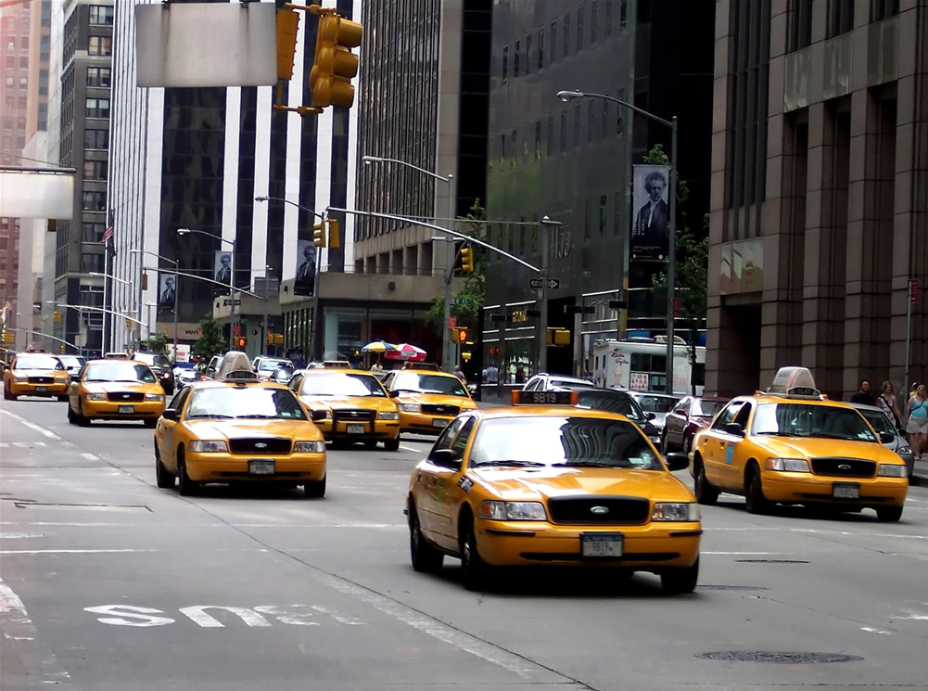
SA-1
Factors Influencing Repeat Passenger Rates
Trip Experience
Competitive Pricing and Public Infrastructure's Impact
City Focus
City Demographics
Socioeconomic and lifestyle patterns

Slide 33
SA-2
Tourism vs. Business Demand Impact
Impact of Tourism Seasons and Local Events on Goodcab’s Demand in Tourist Cities Peak Seasons: Surge in ride demand Festivals & Events: Increased transportation needs from locals and tourists
Effect of Local Events on Goodcabs Demand in Business Cities Business cities see demand spikes during events (conferences, meetings, festivals). Increased ride volumes
Impact of Tailored Marketing Efforts on Trip volume Aligning marketing strategies with key events in tourism and business cities helps increase trip volumes.

Slide 34

SA-3
Emerging Mobility Trends and Goodcabs' Adaptation
Emerging Mobility Trends Impacting Cab Service Market in Tier-II Cities
Electric Vehicles (EVs) Adoption | Green Energy Infrastructure
Hybrid Vehicles Adoption
Benefits of Integrating EVs and Hybrids for Goodcabs
Lower Operational Cost | Early Adoption of Green Infrastructure
Brand Image | Cost Reduction

Slide 35

Partnership Opportunities with Local Businesses
SA-4
Opportunities to Partner with Local Businesses
Hospitality and Tourism | Retail and Dining
Events and Corporate Needs | Transit Hubs
Benefits of Partnerships
Boost in Demand | Improved Customer Loyalty
Brand Presence | Cross-Promotion

Slide 36

Additional Data Collection for Enhanced Data-Driven Decisions
SA-5
Customer Behavior and Preferences
Peak Activity Analysis | Customer Profiling
Payment Preferences
Operational Efficiency
Driver and Vehicle Performance | Wait and Pickup Times
Market Trends and External Factors
Competitive Analysis | Event and Tourism Trends

Slide 37

Recommendations:
Enhance Passenger Experience
Strategic Partnerships and Marketing
Innovative Ride Options
Dynamic Pricing and Fleet Transition
Market Trends and Resource Optimization

Slide 38


